Slide 1
Breaking the Code

Slide 2
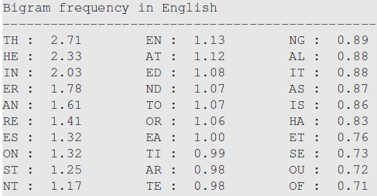


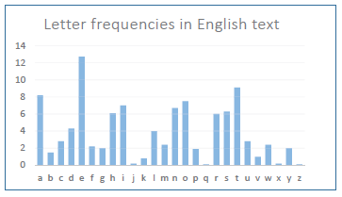
https://onlinetoolz.net/letter-frequency

